Slide 1
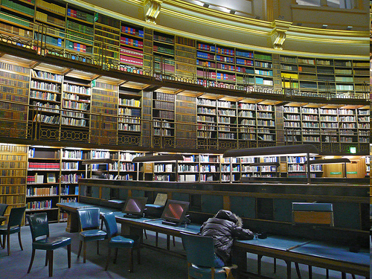
Open Access GLAM: CC and the Public Domain for Galleries, Libraries, Archives and Museums Jessica Coates Global Network Manager, Creative Commons National Library of Australia May 2014
culture exhausts anyone by procsilas, http://www.flickr.com/photos/procsilas/343784334/
<footer>

Slide 2
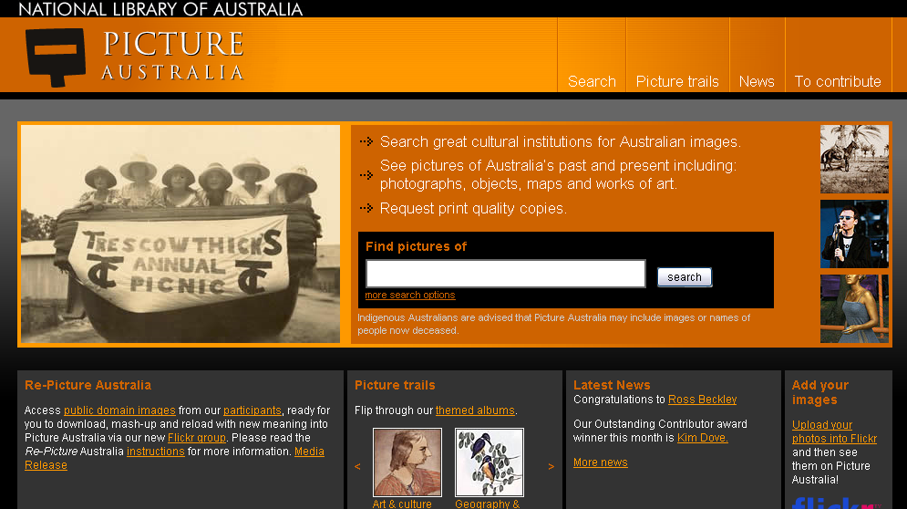
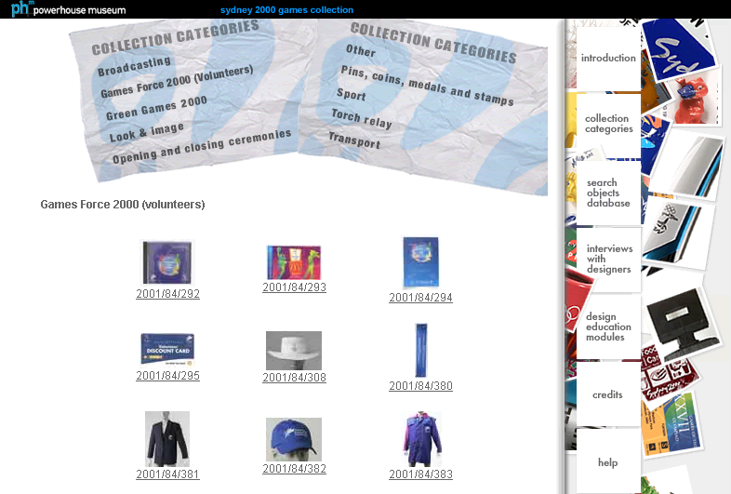
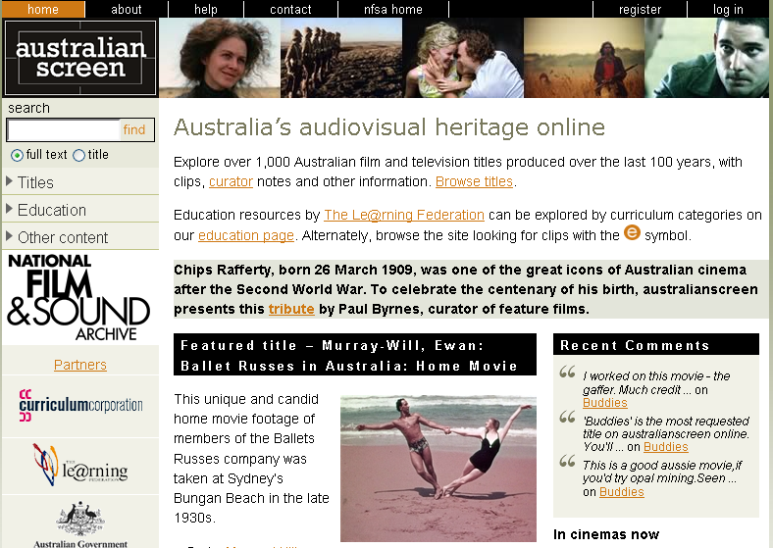
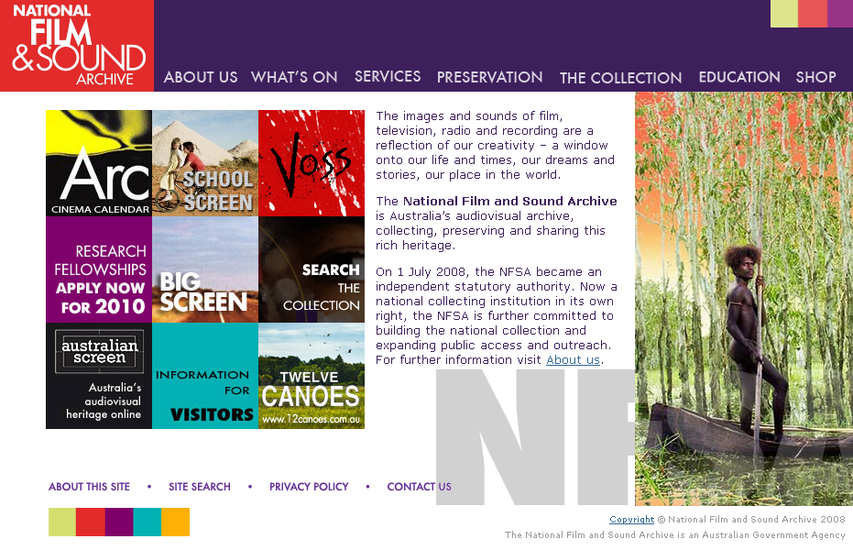
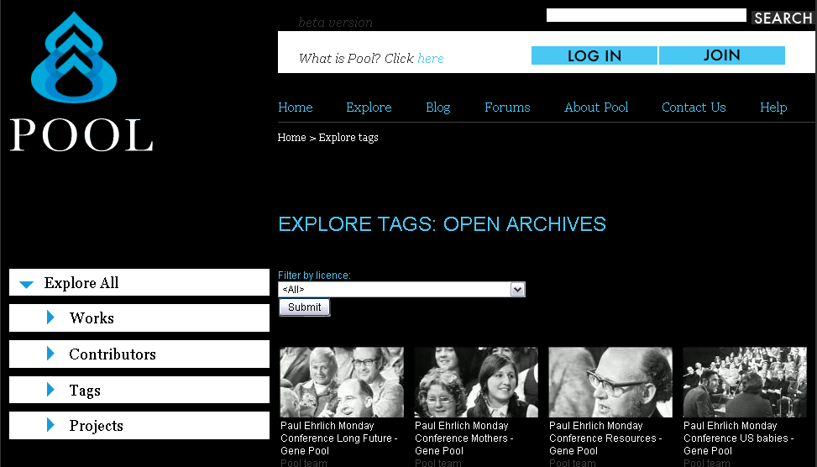
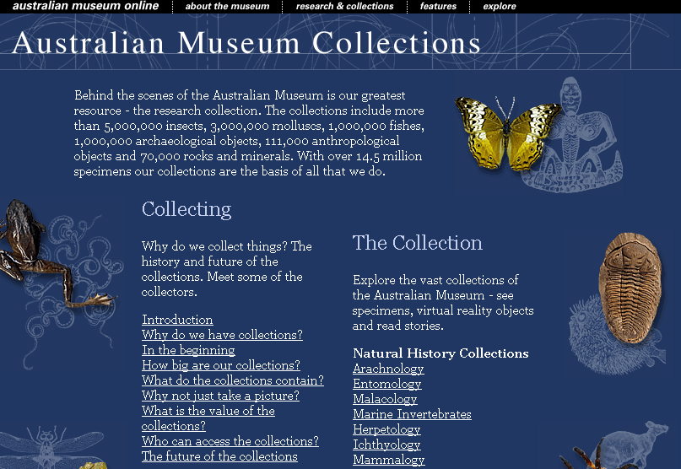
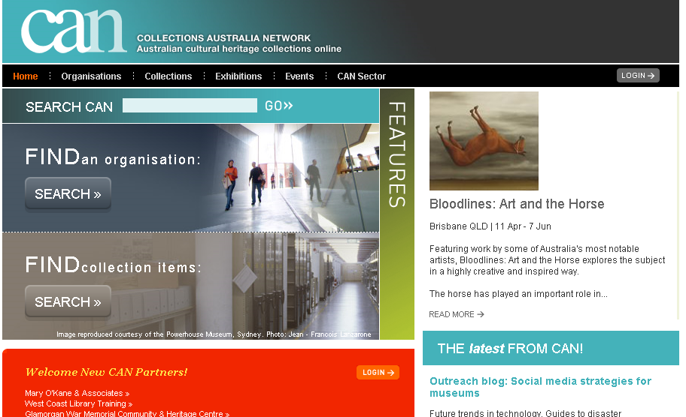
Institutions are already sharing – we know the benefits of being online
Notes:
The open access movement is in a better place than its ever been before, as far as gaining ‘mainstream’ acceptance and being adopted by large players
There have, of late, been lots of official statements endorsing open access – from the OECD, from Venturous Australia etc

Slide 3
Institutions are already sharing – we know the benefits of being online
it’s still difficult or illegal to use most of this material without going through cumbersome processes
Notes:
The open access movement is in a better place than its ever been before, as far as gaining ‘mainstream’ acceptance and being adopted by large players
There have, of late, been lots of official statements endorsing open access – from the OECD, from Venturous Australia etc

Slide 4
Institutions are already sharing – we know the benefits of being online
it’s still difficult and illegal to use most of this material without going through cumbersome processes
open materials are materials which you can use without asking permission – permission has already been given
Notes:
The open access movement is in a better place than its ever been before, as far as gaining ‘mainstream’ acceptance and being adopted by large players
There have, of late, been lots of official statements endorsing open access – from the OECD, from Venturous Australia etc

Slide 5
there are competing pressures re client, institution, creator and donor interests
orphaned works
under-rating the public domain
cost of copyright clearance
donor concerns
cost of digitisation
risk aversion
control
protection of revenue streams
prioritisation
asset tracking
lack of certainty in law
licensing questions
Notes:
The open access movement is in a better place than its ever been before, as far as gaining ‘mainstream’ acceptance and being adopted by large players
There have, of late, been lots of official statements endorsing open access – from the OECD, from Venturous Australia etc

Slide 6
3 levels of open:
1. Accessibility – freely available online
2. Technical – format allows download and adaptation
3. Legal – permission to use

Slide 7
3 levels of open:
1. Accessibility – freely available online
2. Technical – format allows download and adaptation
3. Legal – permission to use

Slide 8

Notes:
Creative Commons comes in. Hopefully you’ll remember from the last lecture I gave,

Slide 9
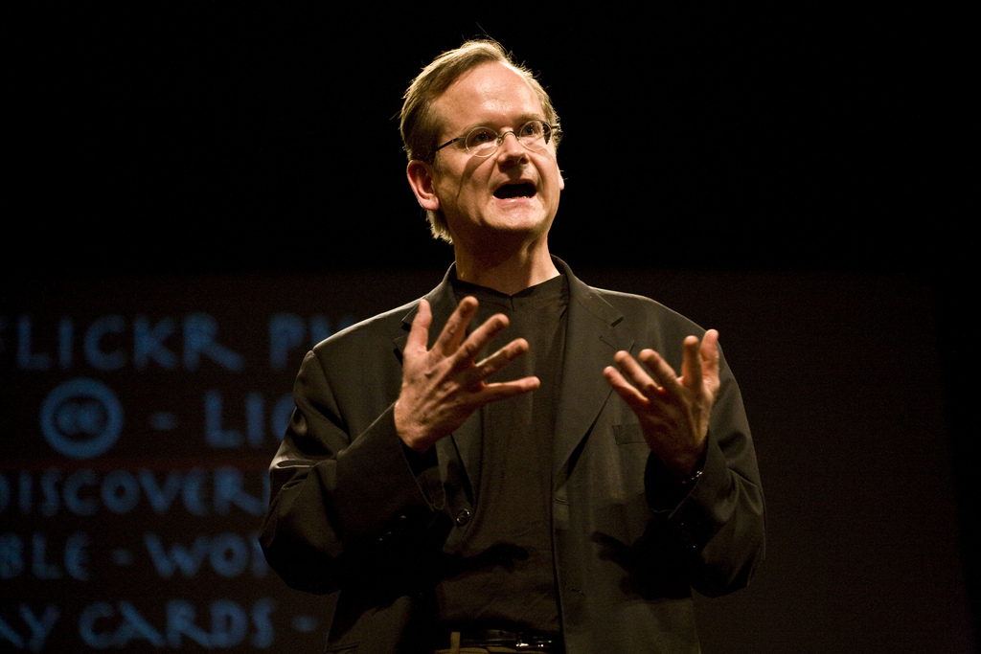
Larry Lessig by Robert Scoble, http://www.flickr.com/photos/scobleizer/2236177028/ CC BY 2.0

Slide 10
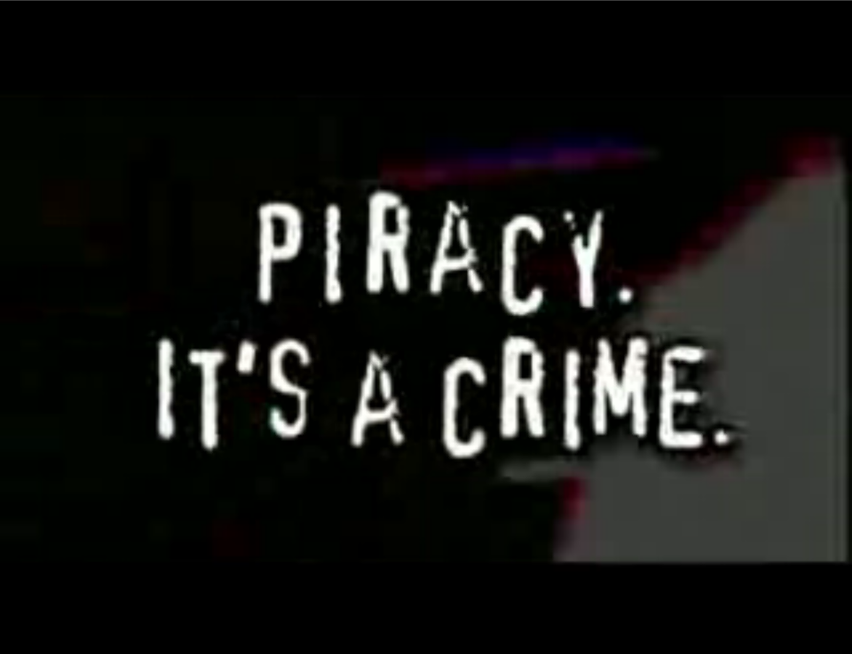
AUSTRALIA
part of the Creative Commons international initiative
CRICOS No. 00213J

Slide 11
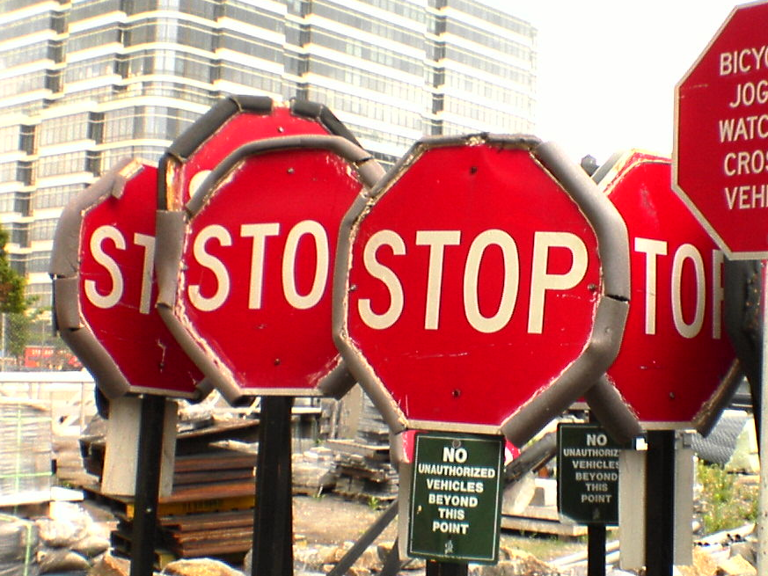

this is what people think copyright is
2.0 Stop by brainware3000, http://flickr.com/photos/brainware3000/22205084
Notes:
This is what makes copyright hard.
Because you need the permission of each of these different copyright owners before you can use the work.
In fact, they need each other’s permission before they can use the final work (eg CD), such as publishing it or putting it online.
Well – in most circumstances you need their permission. There are exceptions:

Slide 12
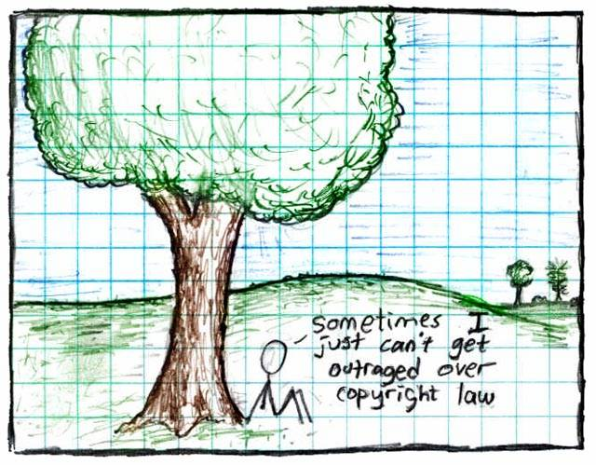



"", Randall Munroe, ,
AUSTRALIA
part of the Creative Commons international initiative
CRICOS No. 00213J
Notes:
Some just say ignore copyright law – rip, mix, burn
This is ok if you’re an private user, or an obscure artist – can choose to take risk
But doesn’t work for schools, libraries, museums, charities, academics, short film makers entering into competitions, DJs releasing a commercial CD etc
Plus, the music labels and hollywood are suing people now – and in the UK they’re threatening to cut off people’s internet connections.

Slide 13

this is what it should be
2.0 Sound Board by Chris Costes, http://www.flickr.com/photos/33852688@N08/3938863162/
Notes:
This is what makes copyright hard.
Because you need the permission of each of these different copyright owners before you can use the work.
In fact, they need each other’s permission before they can use the final work (eg CD), such as publishing it or putting it online.
Well – in most circumstances you need their permission. There are exceptions:

Slide 14
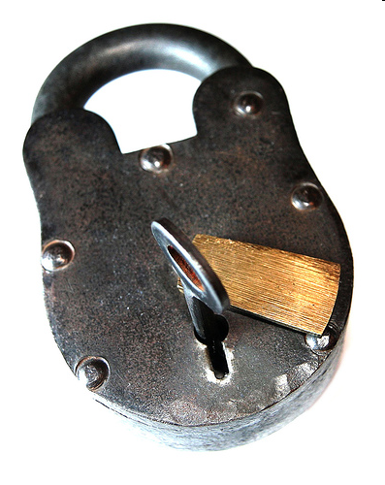
open licensed material can be used without worrying about copyright laws or exceptions – by anyone, anywhere, with assurance
Lock by available at under a Creative Commons Attribution Licence

Slide 15

CC provides free licences
that creators use to tell people
how their material can be used
Notes:
Non-profit
Founded in 2001
These academics became concerned that the default copyright laws that applied in most countries were restricting creativity in the digital environment by preventing people from being able to access, remix and distribute copyright material online
Taking inspiration from the open source movement, they decided to develop a set of licences that creators could use to make their material more freely available without giving up their copyright
They wanted to replace the standard “all rights reserved” model with a new, more flexible, “some rights reserved”

Slide 16
this creates a pool of material
that can be shared and reused
- legally
Notes:
Non-profit
Founded in 2001
These academics became concerned that the default copyright laws that applied in most countries were restricting creativity in the digital environment by preventing people from being able to access, remix and distribute copyright material online
Taking inspiration from the open source movement, they decided to develop a set of licences that creators could use to make their material more freely available without giving up their copyright
They wanted to replace the standard “all rights reserved” model with a new, more flexible, “some rights reserved”

Slide 17
which in turn enables a culture of sharing
Notes:
Non-profit
Founded in 2001
These academics became concerned that the default copyright laws that applied in most countries were restricting creativity in the digital environment by preventing people from being able to access, remix and distribute copyright material online
Taking inspiration from the open source movement, they decided to develop a set of licences that creators could use to make their material more freely available without giving up their copyright
They wanted to replace the standard “all rights reserved” model with a new, more flexible, “some rights reserved”

Slide 18
why CC?
Standardisation is good –
usability, compatibility
Licences are good –
international, applied
Easy to use
Metadata is key

Slide 19




Licence Elements
Attribution – credit the author
Noncommercial – no commercial use
No Derivative Works – no remixing
ShareAlike – remix only if you let others remix
Notes:
The first CC licences were released in 2002
The central to each of the CC licences are the four licence elements – Attribution, noncommercial, no derivative and sharealike
These represent restrictions that copyright owners may want to put on how people can use their material.
As you can see, each of the elements has a symbol that can be used to ‘represent’ each of these elements
this makes the licences easier understand – in theory, once a person is familiar with the CC licences, they should be able to recognise what uses are allowed simply by looking at the symbols

Slide 20
Attribution
Attribution-ShareAlike
Attribution-Noncommercial
Attribution-Noncommercial-ShareAlike
Attribution-NoDerivatives
Attribution-Noncommercial-NoDerivatives
4.0 – international, easier, clearer (and database rights)
Notes:
Users can mix and match these elements to set the conditions of use for their material
So, for example, an author may be happy to allow private uses of their work, but may want to limit how it can be used commercially.
They may also want people to remix their work, but only so long as that person attributes them and makes the new work available for others to remix
So they can choose the Attribution-noncommercial-sharealike licence

Slide 21

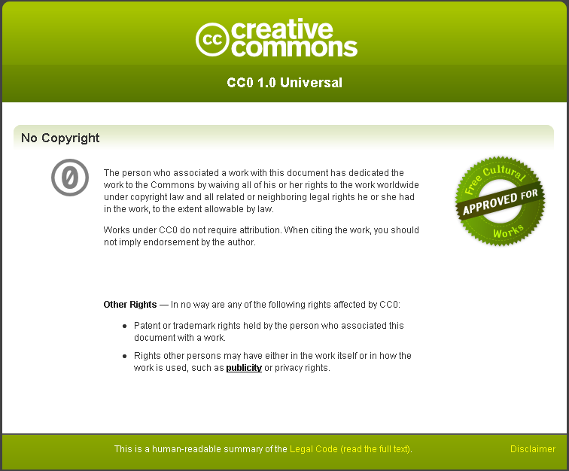
CC Zero

Slide 22


Slide 23
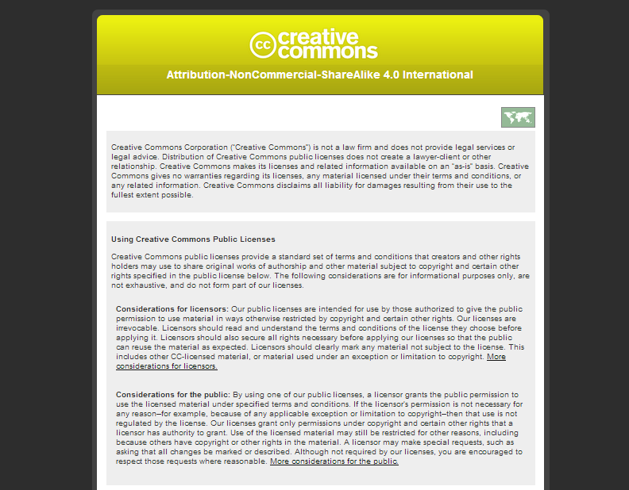
Notes:
although my experience working with the literary world, I sometimes suspect they think the world is more like this; FLAT!

Slide 24
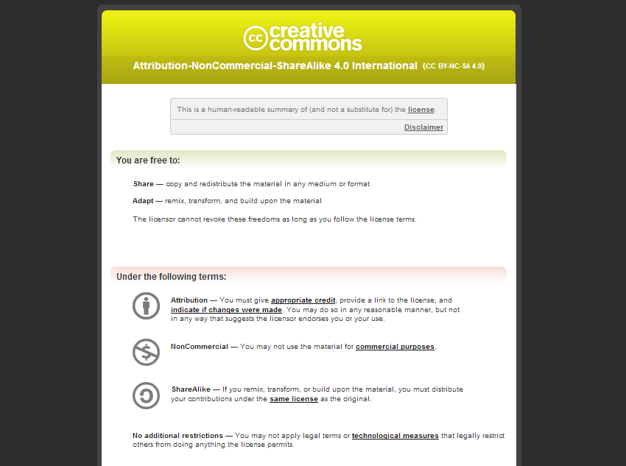
Notes:
although my experience working with the literary world, I sometimes suspect they think the world is more like this; FLAT!

Slide 25
Notes:
although my experience working with the literary world, I sometimes suspect they think the world is more like this; FLAT!

Slide 26
Notes:
although my experience working with the literary world, I sometimes suspect they think the world is more like this; FLAT!

Slide 27
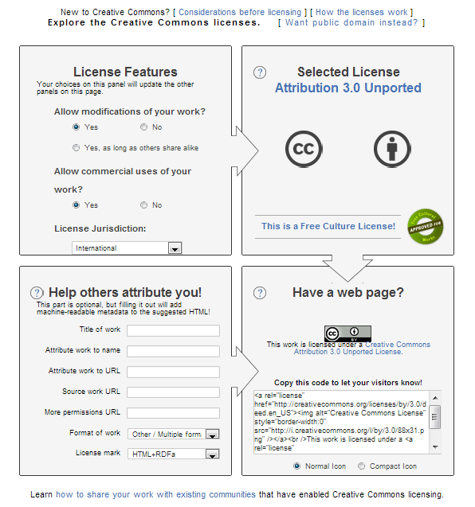

Slide 28
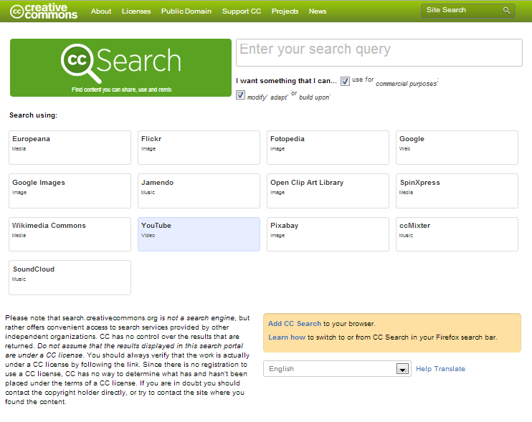
search.creativecommons.org

Slide 29


http://creativecommons.org.au/infopacks/findingmaterial

Slide 30
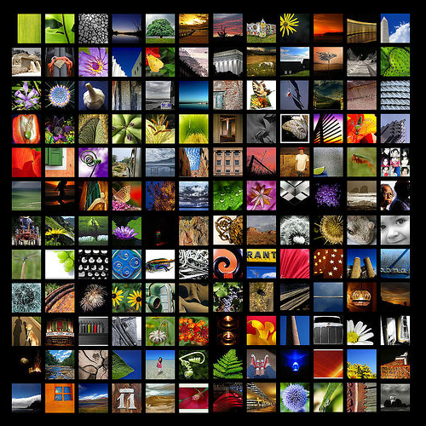
More than 500 million CC objects on the internet
Almost 300 million photos on Flickr alone
Thank you for sharing by Clearly Ambiguous available at http://www.flickr.com/photos/clearlyambiguous/39896923/ under a Creative Commons Attribution 2.0 licence
Notes:
So – looking at how the CC licences are being used
According to the latest statistics from the CC website, there are currently about 140million webpages that use a CC licence
As you can see, almost all of them contain the BY element – that’s because it was made compulsory for all the licences except the public domain licences after the first year, because pretty much everybody was using it anyway
The majority also, unsurprisingly, choose the non-commercial element
Interestingly, next most popular is ShareAlike, not noderivatives – this shows that there is still a strong focus on fostering creativity among CC community, and that, rather than trying to lock their material up, people are happy for it to be remixed, as long as the new work is also sharedEven more interesting is how these statistics are changing over time
Even more interestingly – if you look at how the licences is being used over time, people are gradually moving towards more liberal licences with less restrictions on them
This movement seems to indicate that as people become more familiar with the licences, they are more comfortable allowing greater use
This is supported by anecdotal evidence from CC users who, after initially publishing their material under restrictive licences that don’t allow derivatives, often ‘re-release’ their material to allow new works

Slide 31











Notes:
In writing the licences, the main goal was to ensure that the licences are:
Voluntary – contrary to some claims, CC isn’t anti-copyright. It just aims to provide options for those copyright owners who do want to make their material more freely available
Flexible – unlike other parts of the open access movement, CC licences are specifically designed to provide a range of options for licensors, so that they can choose exactly how they want their material to be used
Easy to understand – the academics designing the licences felt that one of the biggest problems with default copyright law is that its so hard for both copyright owners and users to understand. So the licences are specifically designed to be as simple as possible.
And, of course, freely available for everyone to use

Slide 32
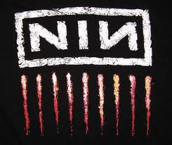
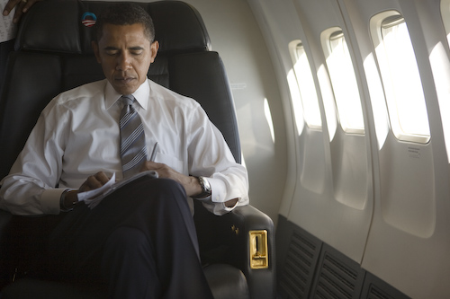
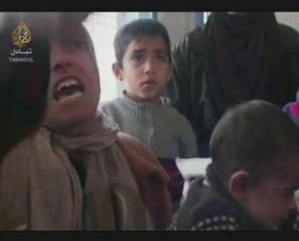







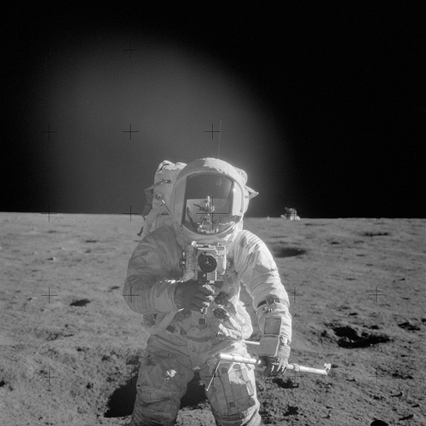


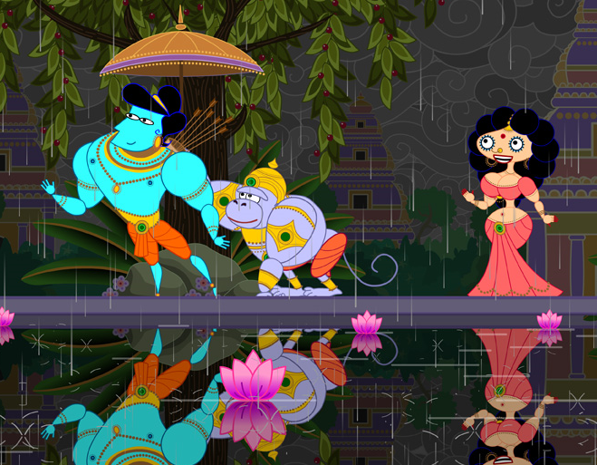
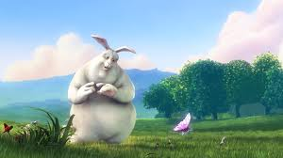

Notes:
Creative Commons comes in. Hopefully you’ll remember from the last lecture I gave,

Slide 33
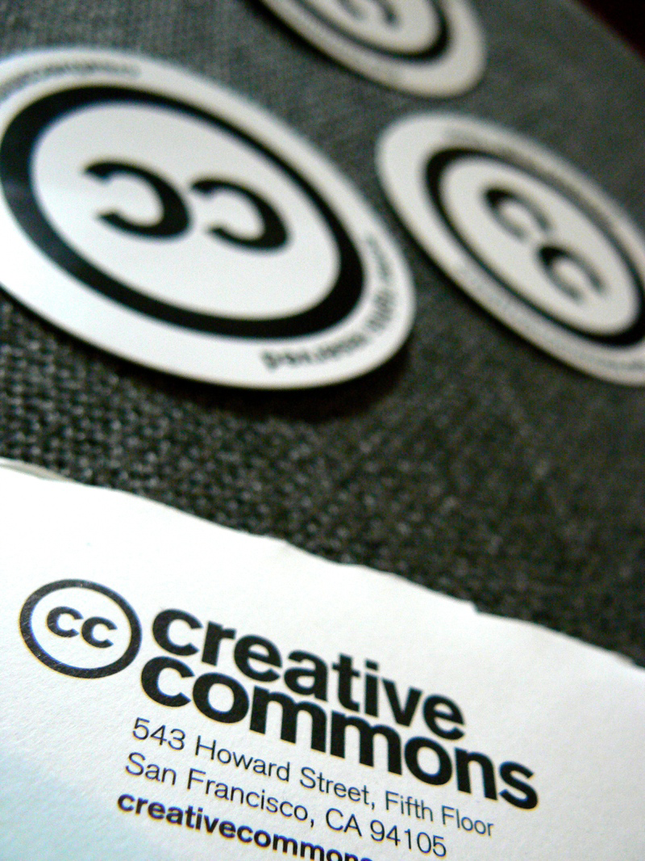
Creative Commons provides resources that you and your users can legally copy, modify and reuse
my CC stickers have arrived!!! by laihiu available at
http://www.flickr.com/photos/laihiu/290630500/
under a Creative Commons Attribution 2.0 licence

Slide 34
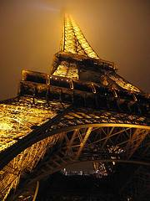
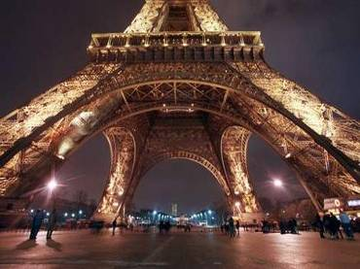
How does it work?
© Sydney Morning Herald
www.smh.com.au
Eiffel Tower at night by rednuht,
http://www.flickr.com/photos/rednuht/275062341/,

Slide 35
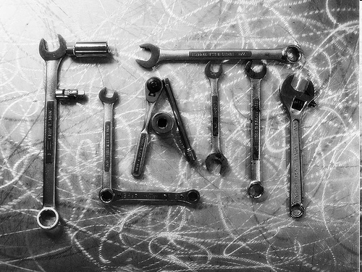
It also provides a tool for managing your own copyright
Tooled Flatty by flattop341 available at http://www.flickr.com/photos/flattop341/1085739925/
under a Creative Commons Attribution 2.5 licence
CRICOS No. 00213J

Slide 36
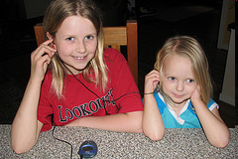
Girls Sharing a mp3 Player by terren in Virginia available at
http://www.flickr.com/photos/8136496@N05/2275475657/
under a Creative Commons Attribution 2.0 licence
to allow collaboration and sharing with other students, teachers, the world

Slide 37
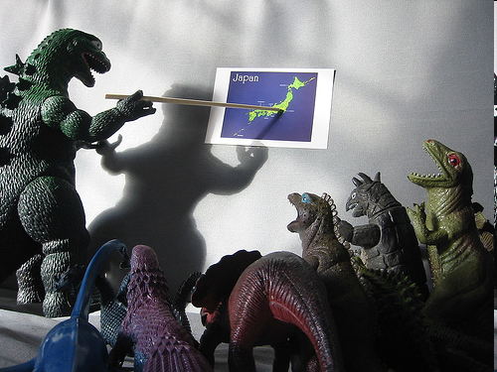
and it can help you teach students about copyright
Introduction to monstering by WorldIslandInfo.com of http://www.futuristmovies.com/
available at http://www.flickr.com/photos/76074333@N00/318034222/ under a Creative Commons Attribution 2.0 licence

Slide 38
what can GLAMs do, and how?
<footer>

Slide 39
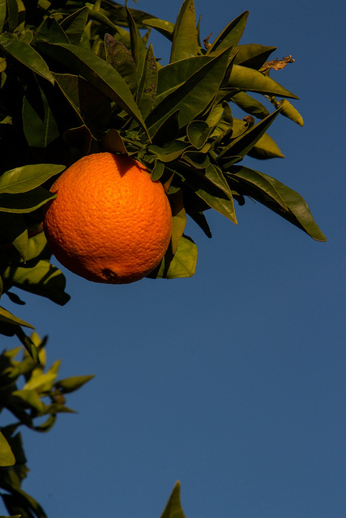
low hanging fruit
1. Public domain works
2. Materials with easy permissions
3. Institution's own copyright
4. Orphan works?
Sunrise Orangr by Don McCollough, CC BY http://www.flickr.com/photos/69214385@N04/8509517971/in/photostream/

Slide 40
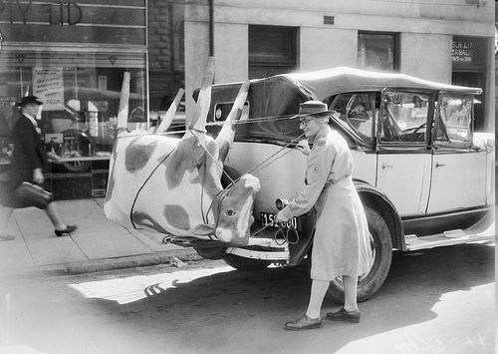
public domain material
Most films and photographs before 1955; other materials if author died before 1955.
Can do anything you want without asking extra permission (even if the donor doesn’t like it)
Can be re-used from archive websites without the archive’s permission (even if archive/donor doesn’t like it)
A papier-mache cow on Mrs Mellor’s car, 1944, Herald Newspaper, Australian War Memorial collection, No known copyright restrictions
Users can do anything without permission - even if the donor doesn’t like it, even if institution doesn’t like it.
Watch out for . . . underlying works that are still in copyright (eg script); risk averse policies – that require absolute proof of public domain status
Notes:
The open access movement is in a better place than its ever been before, as far as gaining ‘mainstream’ acceptance and being adopted by large players
There have, of late, been lots of official statements endorsing open access – from the OECD, from Venturous Australia etc

Slide 41
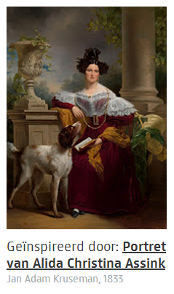
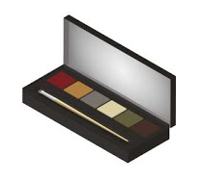
how?
Bad practice to claim copyright in PD works (even high quality) - Bridgeman v Corel
Don't use terms of use to try to restrict – probably not effective and bad practice
Ownership of object =/ right to prevent copying
Users not subject to donor agreements
Do mark works as PD - use CC's PD Mark (it has metadata)
Use CC0 to make things PD if you have the rights
If cautious use custom statement - eg “no known rights”
Make it work for you – Eg Rijkstudio – 150,000 PD works, high res, commercial use; massive publicity (competition), community, sales (see also Powerhouse, Pratham Books)
Notes:
The open access movement is in a better place than its ever been before, as far as gaining ‘mainstream’ acceptance and being adopted by large players
There have, of late, been lots of official statements endorsing open access – from the OECD, from Venturous Australia etc

Slide 42
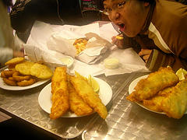
with permission
you can do anything if you have the copyright owner’s permission
sometimes seems an insurmountable barrier (orphaned works)
can be a useful tool for easy materials, eg: new donations; material produced for library (eg digital storytelling); material with a single identifiable copyright owner
:/ -
Build copyright into donor agreements, with OA as an option - giving copyright owners a choice can have positive results
Work with donors/community to create OA native materials
Build OA into your outreach initiatives – make it work for you
Watch out for. . . copyright infringement in third party materials
Notes:
The open access movement is in a better place than its ever been before, as far as gaining ‘mainstream’ acceptance and being adopted by large players
There have, of late, been lots of official statements endorsing open access – from the OECD, from Venturous Australia etc

Slide 43
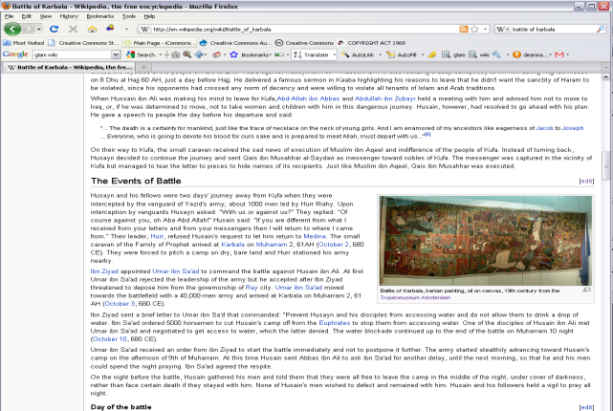
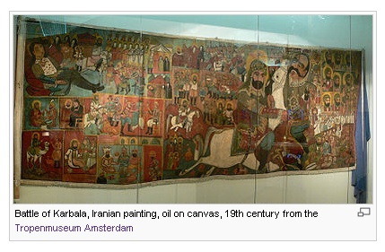
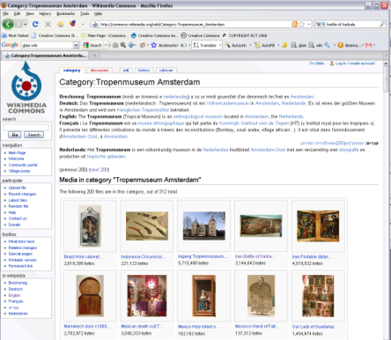
Tropenmuseum
museum of the tropics, Amsterdam
“crowdsourced” open access - invited public to photograph collections and upload to Wikicommons (under CC BY-SA)
350+ photographs now on Wikicommons for use by museum and on Wikipedia – with link back
It was an easy way to…engage new audiences…[and] spread the stories from the collection…In the end I think more people will visit the museum and look online.
– Susanne Ton, Manager of Multimedia Production, Tropenmuseum
http://www.youtube.com/user/wikimedianl#play/all/uploads-all/0/4aPatvL5kvo
Notes:
Click and flick has turned out to be highly successful, with over 9,000 photos uploaded since January
This may not seem like much on internet scale, but it’s a huge number for a library collection
It’s also significantly raised the profile of the PictureAustralia collection, with the NLA reporting much higher usage, even during traditionally slow periods
The NLA doesn’t have any statistics on how many people are using CC licences, but they say anecdotally that they think it is a large portion, or even the majority.

Slide 44
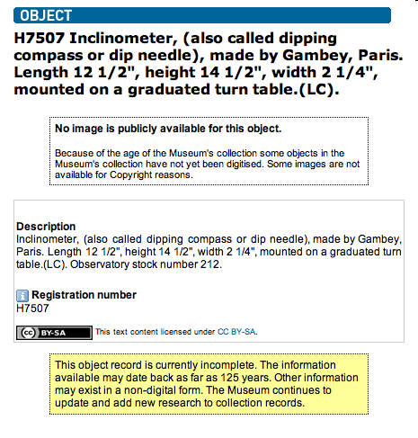
institution’s copyright
Materials produced as part of an officer’s employment owned by the institution
These can be made available on terms of your choosing
Institutions produce large amounts of material that isn’t monetized and can be easily licensed eg catalogue descriptions, articles, policies, educational materials
Doesn't have to be all or nothing – licence part, raw, low res (eg Al Jazeera)
Powerhouse Museum collection record
Think about who you want to use the material and how - work out your license from there
Think about compatibility – eg if you want materials to be used on Wikipedia they must be CC0, BY or BY-SA
Watch out for. . . third party content; restrictive internal policies – knee jerk restriction of material without good reason
Notes:
The open access movement is in a better place than its ever been before, as far as gaining ‘mainstream’ acceptance and being adopted by large players
There have, of late, been lots of official statements endorsing open access – from the OECD, from Venturous Australia etc

Slide 45
data
Increasingly important - for sharing, discovery, data=mining
Very low hanging fruit – often not covered by copyright, where is owned by institution
Do license your data – international rules are too variable to rely on public domain
Best practice is CC0 – to ensure maximum compatibility and prevent attribution stacking – norms can ask for attribution (Europeana, Harvard, British Library)
Next best CC-BY – if really want attribution to be legal requirement or are concerned about uncertainties in Oz law (OCLC)
Watch out for. . . restrictions on remix which silo data eg ShareAlike

Slide 46
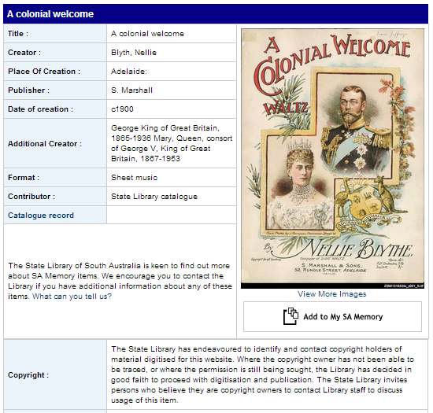
Orphan works?
Possibly a 4th low hanging fruit? (depending on how risk averse you are)
More likely to be covered by fair use than other works, and other exceptions in other jurisdictions
Use strategies to manage risk eg website statements; processes when owner comes forward
Be thoughtful of what materials you use
Watch out for. . . institutional policies that are too tight (require absolute sureties) or too loose (cavalier)

Slide 47

Thinking Hot by
available at
under a Creative Commons Attribution 2.0 licence
Before you license, think:
What do you want to license?
Who do you want to use the material, and when? Are you choosing the right licence?
Do you have the rights to license the material? Are you using anyone else’s material?
Are you sure? You can't change your mind (or not easily)

Slide 48
final messages
you can make your collection available – look for the easy steps
think carefully about how you’re licensing and why – don’t just assume you should (or can) lock things up
think about costs of current system – could pro-active clearance create efficiencies?
think about new business models – could open access be a benefit?
think about licensing ethics – should you restrict access?
access adds value – something locked in a filing cabinet is no good to anyone
Notes:
The open access movement is in a better place than its ever been before, as far as gaining ‘mainstream’ acceptance and being adopted by large players
There have, of late, been lots of official statements endorsing open access – from the OECD, from Venturous Australia etc

Slide 49
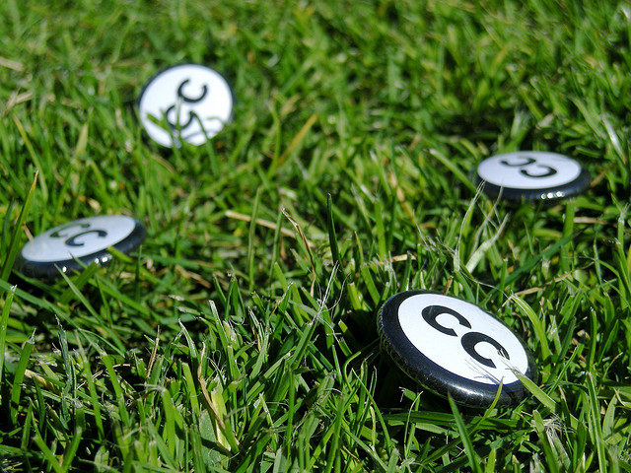

Thanks
Carpeted commons by Glutnix, CC BY 2.0, http://creativecommons.org/licenses/by/2.0/deed.en
creativecommons.org.au
Unless otherwise noted this slide show and all materials in it is licensed under a Creative Commons Attribution licence. For more information see http://creativecommons.org/licenses/by/3.0.

